Slide 1

Finetuning LLMs to Extract Closure Information From National Park Comments
Austin Lackey
This Image Is Generated by DALLE3

Slide 2
Background
MONTH | COMMENT
January | South entrance closed for construction.
February | Annual Parade drove v…
March
… | …
Example Scenario
ENTRANCE/ LOCATION | JAN | FEB | MAR | ….
North Counter | 401 | 200 | 189 | …
South Counter | 0 | 147 | 235 | …
Alpine Peak Trailhead | 35 | 42 | 36 | …
Moose Lodge Campground | 0 | 90 | 80 | …
… | … | … | … | …

Slide 3
The Problem
MONTH | COMMENT
January | 1.) BAIS Ranger left position at beginning of the month. 2.) MIIN has had broken HVAC/air conditioning since June. Idaho has seen record number of days at temps of high 90s-100s; prolonged heat wave has resulted in MIIN Visitor Center closing 3 to 4.5 hours early to mitigate heat exhaustion amongst staff and visitors. 3.) Yellowstone temporarily closed due to severe flooding and, even after reopening, has seen decreased visitation due to cancelled travel plans or potential visitors not knowing that the park is open. A significant portion of MIIN visitation comes from the traffic between YELL and the Pacific Northwest, so MIIN visitation may have similarly decreased. 4.) A large portion of MIIN visitors are semi/retired RV travelers; MIIN visitation may have decreased due to high cost of gas throughout the summer (national average $5.00+). BAIS -- Estimated with a 10% decrease from July BAIS FY22 assumed from the lack of BAIS Ranger during the month of July. Bainbridge Island Japanese American Exclusion Memorial people counters have been broken since 03/2021. MIIN staff based out of Idaho and not able to easily make fixes to BAIS in WA state. The memorial is collectively cared for by the Bainbridge Island Japanese American Exclusion Memorial Association, the Bainbridge Island Japanese American Community, the Bainbridge Island Historical Museum, Bainbridge Island Parks & Recreation District and the Klondike Gold Rush National Historical Park - Seattle.
February | July, 2005 was an exceedingly hot month, with a few days that broke records. High heat in the mid to upper 90s with 70 to 80% humidity resulting in a high heat index. The excesive heat may have been responsible for lower vistation numbers at the Elizabeth Cady Stanton House, which is not air conditioned. The staff at the information desk is careful to inform visitors of this fact on hot days, so that those who have trouble with the heat may make an informed decision on whether or not to take the tour. 4-Jul: Special Event-Reading of the Declaration of Sentiments- 9 10-Jul: AAVW- 13, chapel, film, exhibits, Stanton 11-Jul: Syracuse University- 52 15-Jul: Methodist Center- 20 17-Jul: Women's (Democratic Politicians) Event in Chapel 10:10-10:40 am (Samara Barend for Congress)- 10; Women's Rights Convention Dramatization- 150, 2pm; Fix Air Conditioning!!! 19-Jul: Camp Wanepee- 13 20-Jul: Fix Air Conditioning on 1st Floor!! Had a few complaints from guests. 21-Jul: Rochester Int'l Council ”…………………………………………..
… | ….
400 Parks
12 Months of data
12x400=~4,000 comments
3-5 Iterations…

Slide 4
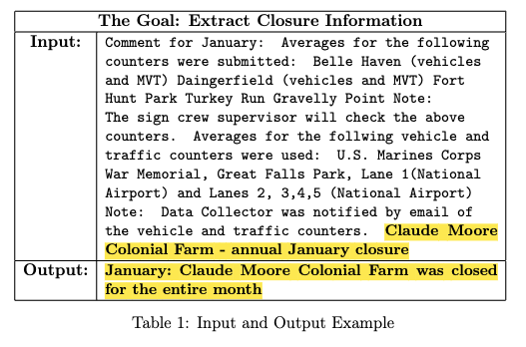
The Goal
Turn long verbose comments into concise closure-specific segments.

Slide 5

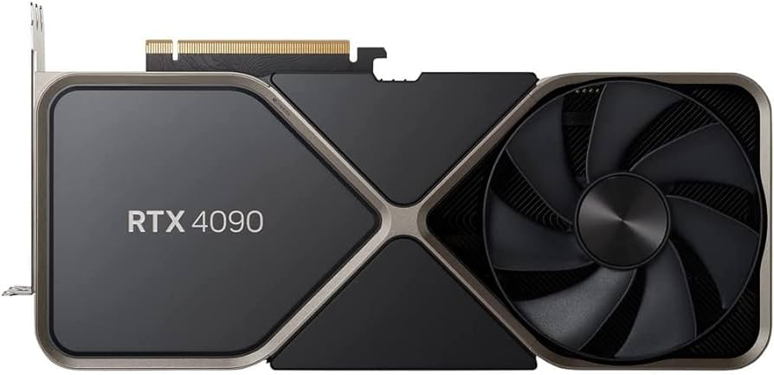
LLMs are great but...
$$$

Slide 6

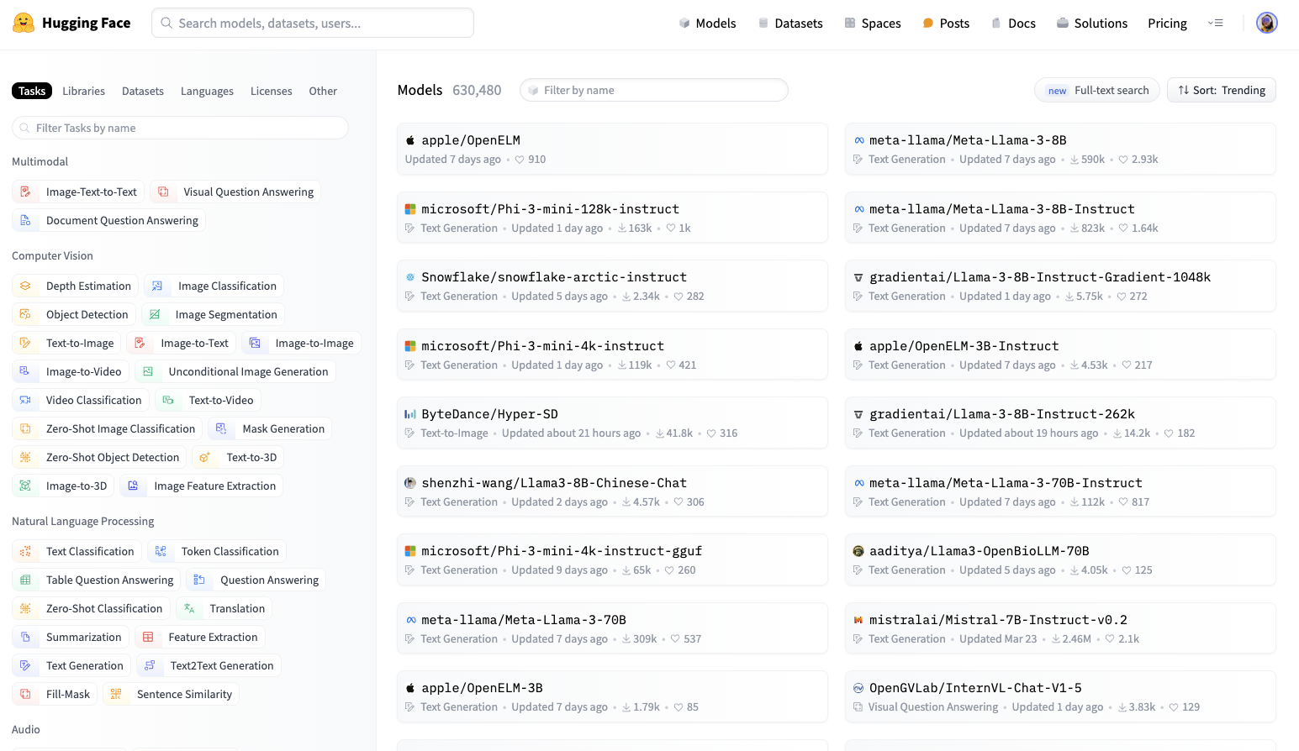
Open Source LLMs

Slide 7
Llama 3 8B
Developed by Meta
Free to download
Goal: Finetune Llama 3 for specific NPS tasks LOCALLY
Credit: DALLE 3

Slide 8

Finetuning
Meta Base Llama
NPS Finetuned Llama
Utilizing the models original knowledge, while training it to specific tasks
Full Parameter Fine Tuning
LoRA Finetuning
Credit: iStock
Credit: DALLE 3
Updates all weights (8B)
Requires lots of time
Requires lots of compute
Requires lots of memory
Leaves original weights “untouched”
Tracks changes
Uses small “Low rank” matrices

Slide 9


Low Rank Adaptation (LoRA)
10 trainable parameters vs. 25
X
=
}
Rank 1
Credit: Austin Lackey

Slide 10

Low Rank Adaptation (LoRA)
Increased Precision/Accuracy
X
=
}
Rank 2
Credit: Austin Lackey

Slide 11
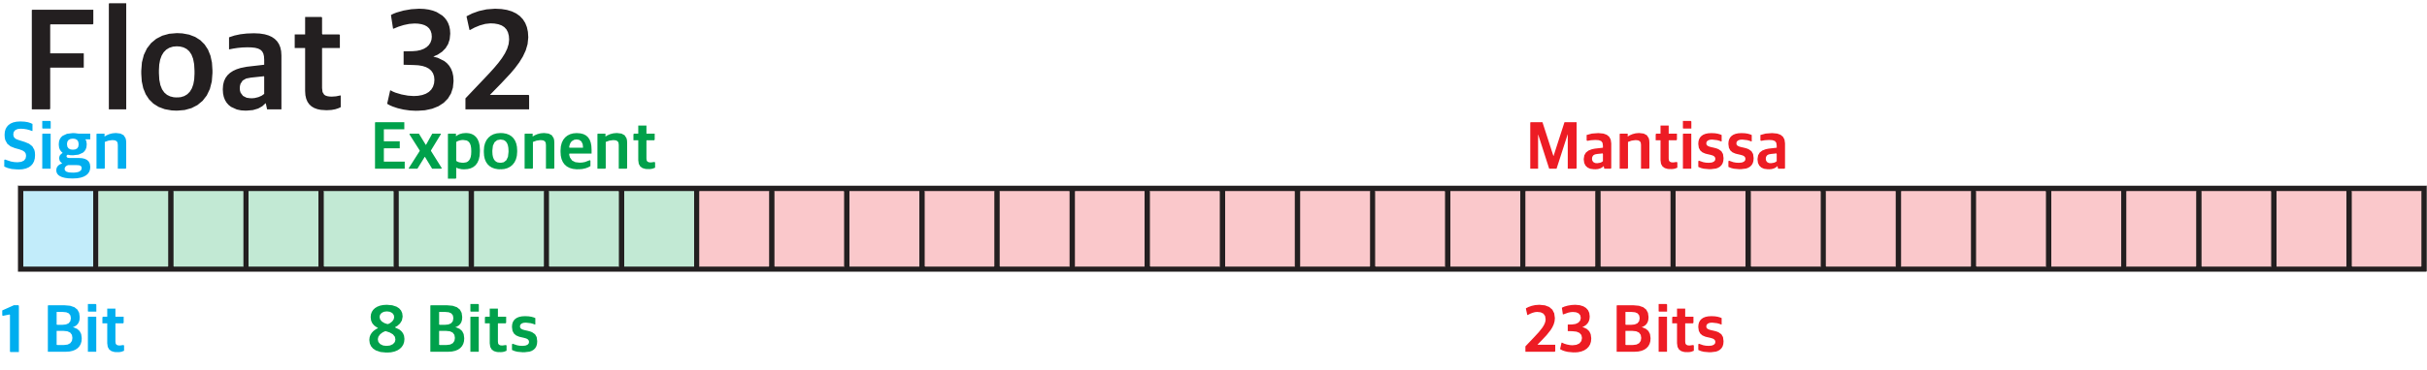
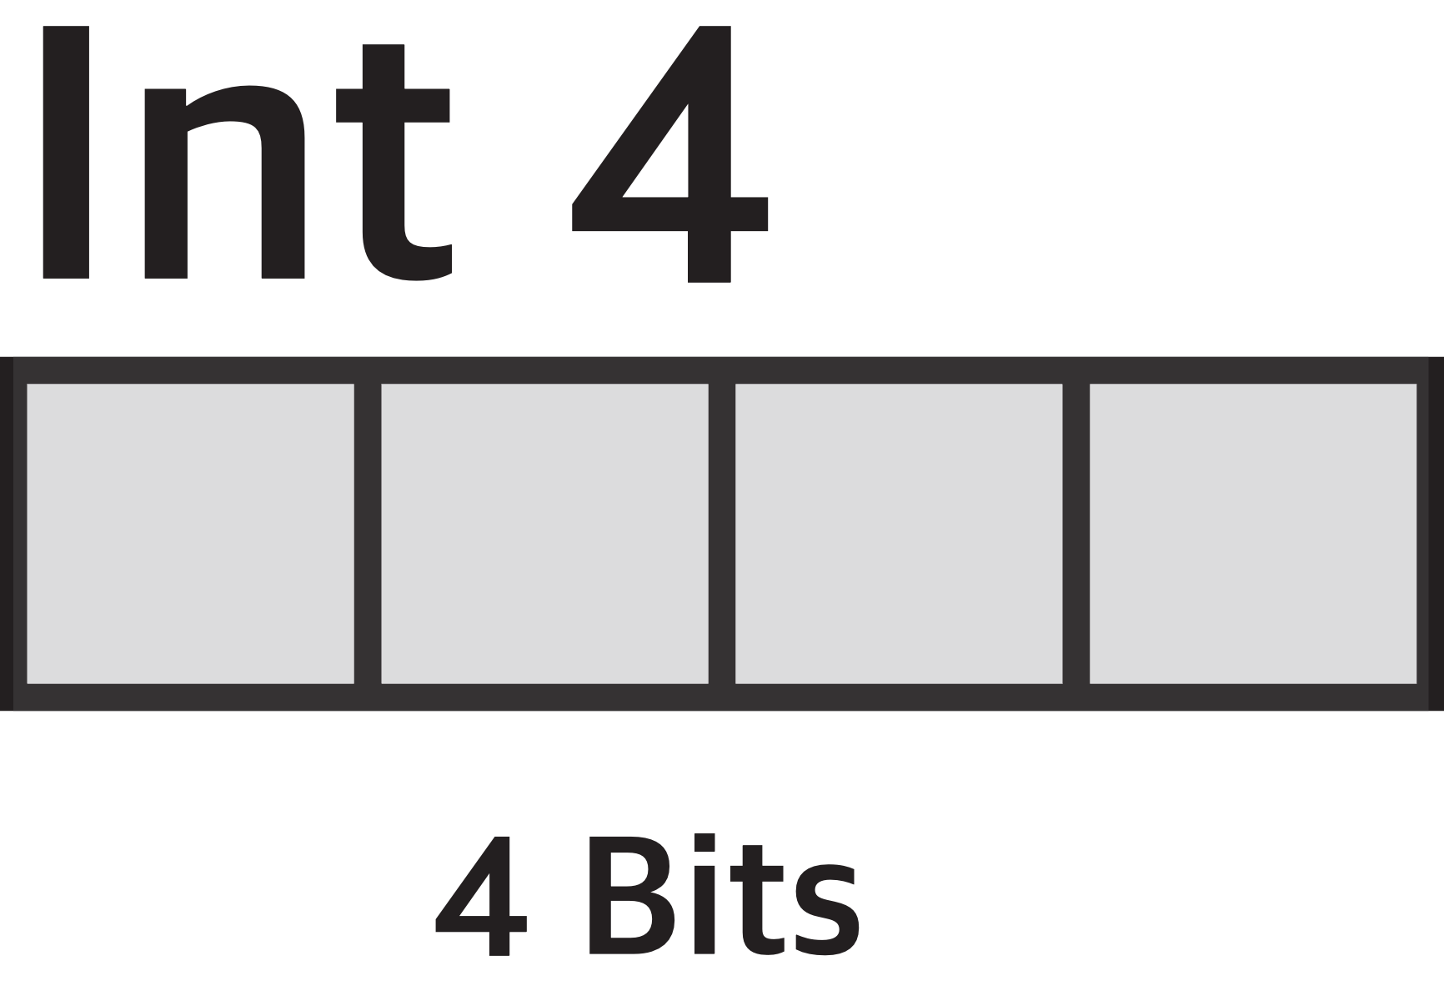
Quantized Low Rank Adaptation (QLoRA)
Credit: Austin Lackey
Credit: Austin Lackey

Slide 12
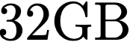
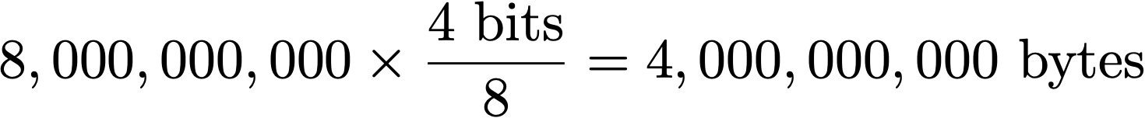

Quantized Low Rank Adaptation (QLoRA)
Llama 3 8B ~ 8 Billion Parameters/Weights

Slide 13
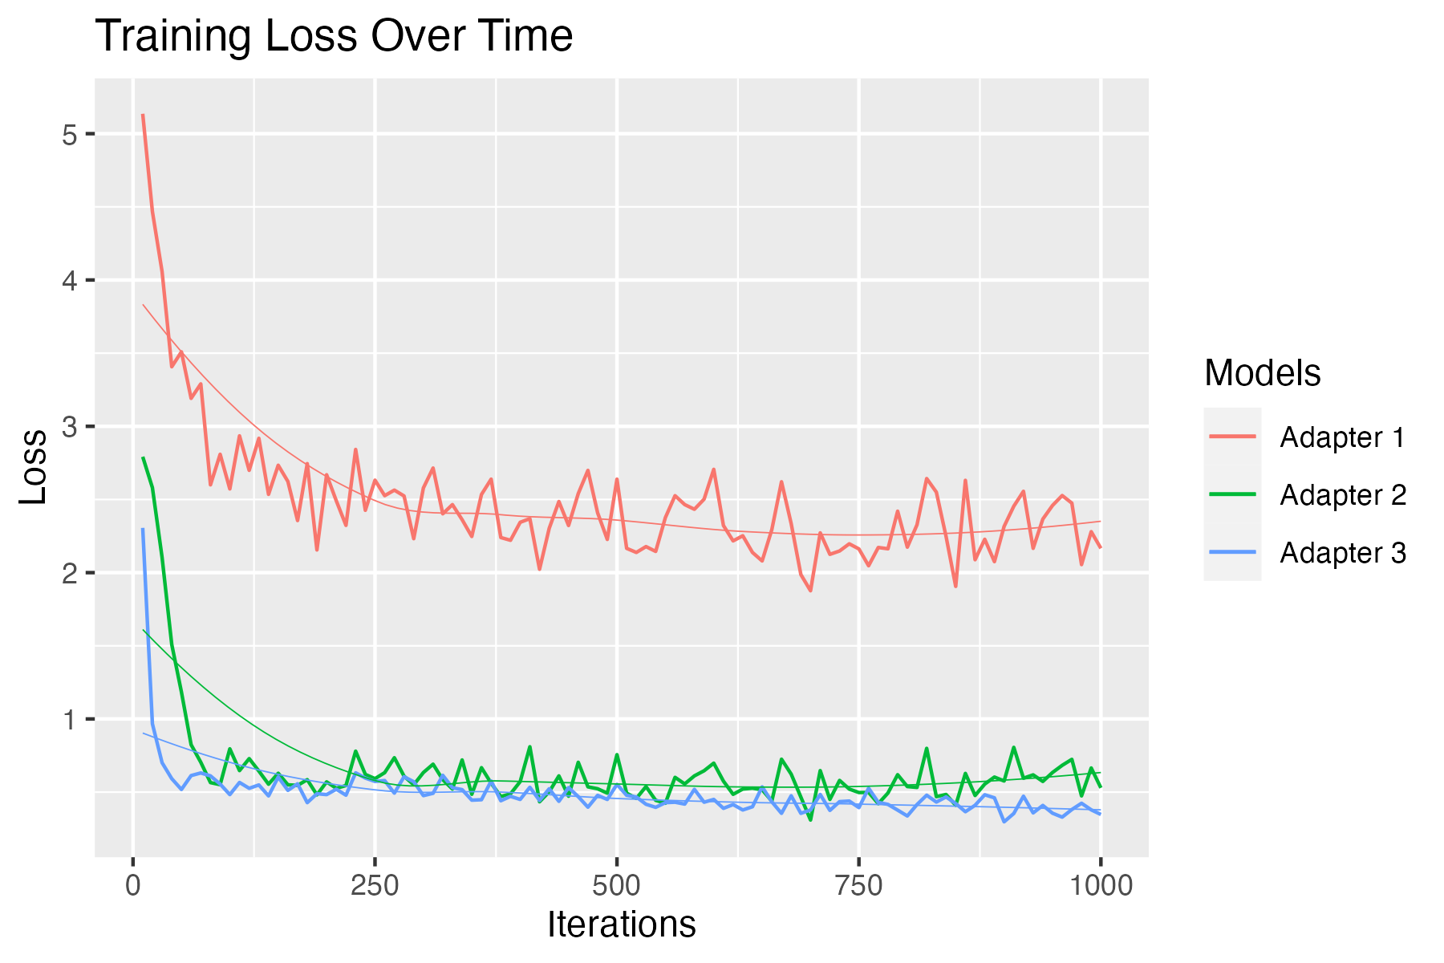
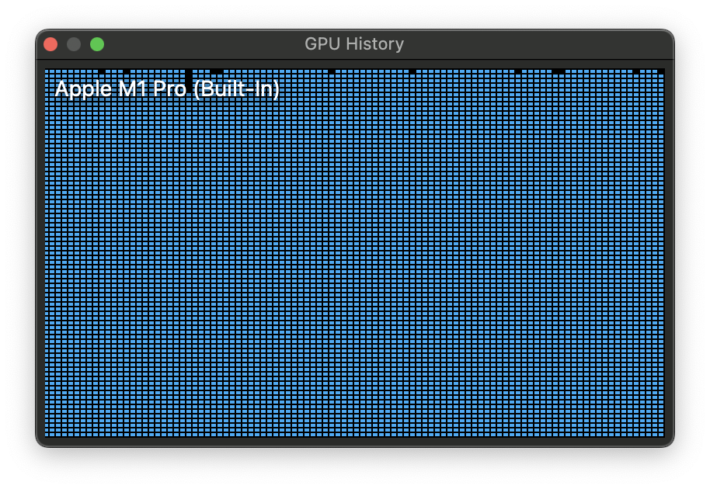
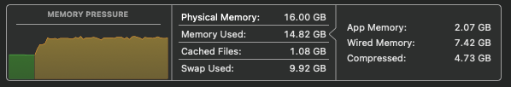
Training Time
~1,500 I/O Samples
10 Hours (max GPU)
Credit: Austin Lackey

Slide 14
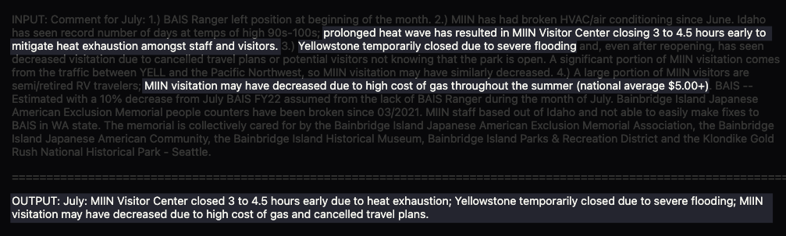
Results
Credit: Austin Lackey

Slide 15
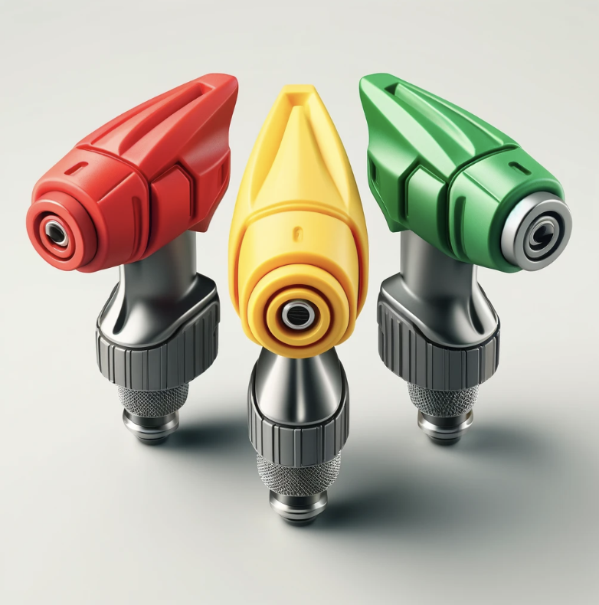
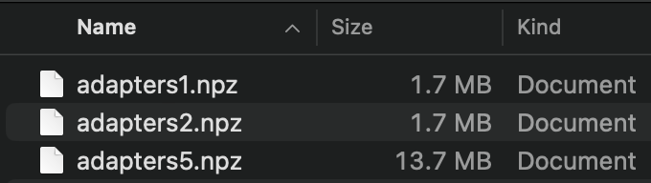
Significance
Credit: Austin Lackey
Credit: DALLE 3

Slide 16
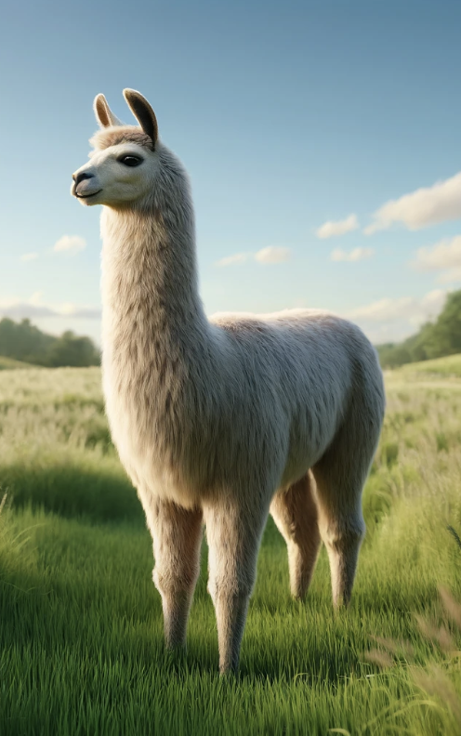

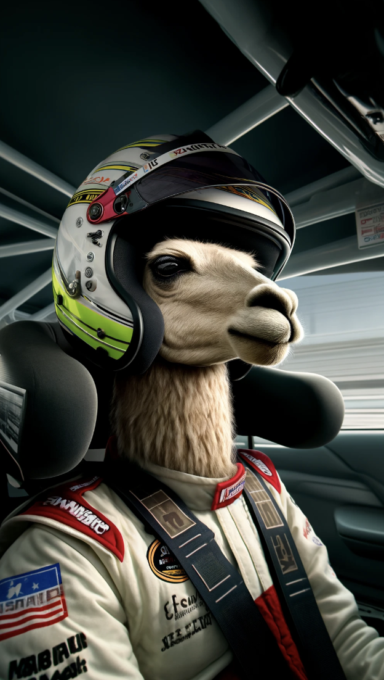

Significance
Base Model (GBs)
Swappable Adapters (MB)
All of these Images are Generated by DALLE3

Slide 17
Thanks!
This Image Is Generated by DALLE3

